Slide 1


Student Performance Analysis and Predictive Modeling
Source: Kaggle Dataset
2025/10/0

Slide 2



CONTENTS
01
02
03
04
Opening & Problem
Key Data Findings
Model & Deployment
ROI & Close

Slide 3

Student Performance Analysis
Predictive Modeling Using Machine Learning
Odunayomide Yakubu
Data Scientist & Analyst

Slide 4
The Challenge We Face
606
13%
vs
Students Flagged as HIGH-RISK
Students Excel
for Dropout
Achieving Top Performance
These aren't just numbers—they're students who need help NOW .

Slide 5
Project Scope & Analytics Plan
Dataset
Method
Goal
6,055 student records
Machine Learning &
15 variables analyzed
Predict & prevent
Predictive Analytics
academic failure
Three-Tier Analytics Approach
1. Descriptive: Understanding current behavior
2. Diagnostic: Explaining why patterns exist
3. Predictive: Forecasting risks before failure

Slide 6

02
Key Data Findings

Slide 7
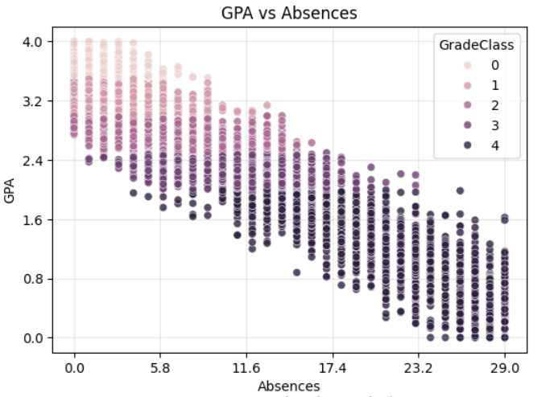
Finding #1: Absences = Academic Disaster
STRONGEST Predictor of Academic Failure
High Performers (GPA 3.0-4.0): Cluster at LOW absence counts.
As Absences Increase: GPAs plummet to the 1.6-2.4 range.
Actionable Insight: The most critical predictor for intervention.
💡 Action Plan:
Automated early-warning attendance triggers.
Wraparound support systems (transport, health).
Immediate counselor assignment.

Slide 8
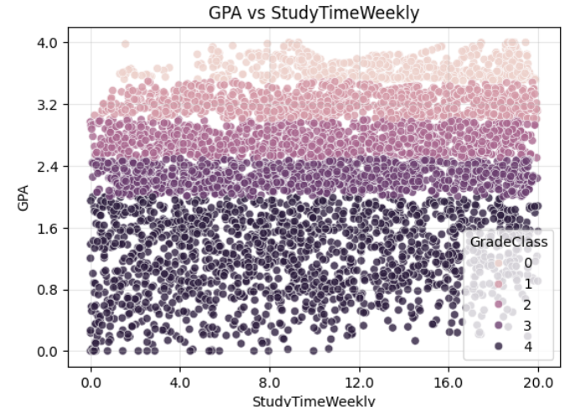
Finding #2: Study Quality > Quantity
SURPRISING DISCOVERY
Hours studied ≠ Better grades
Low-GPA Students: Many study extensively with little gain.
High Performers: Some study moderately, focusing on strategy.
Conclusion: Study strategy matters MORE than raw hours.
💡 Action Plan:
Evidence-based study workshops.
LMS analytics for "high-hours/low-gain" students.
Faculty-led review labs.

Slide 9
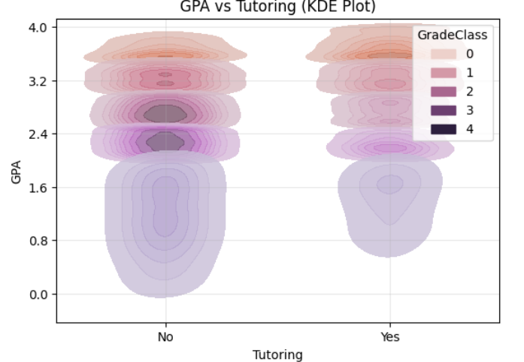
Finding #3: Tutoring is a Game-Changer
Tutored Students
3.2 - 4.0
GPA Range
Non-Tutored Students
0.8 - 2.4
GPA Range
💡 Action Plan:
Rapid tutoring rollout for 606 at-risk students with randomized control groups and weekly KPI tracking.

Slide 10
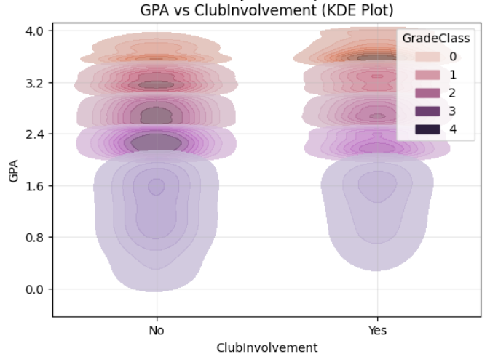
Finding #4: Club Involvement Drives Success
Club Members
3.2 - 4.0
GPA Range
Non-Members
1.6 - 2.8
GPA Range
Why It Works:
💡 Action Plan:
Mentoring & accountability
Better time-management
Peer support networks
Lower barriers (funding, scheduling)
Create academically-linked activities
Proactively invite low-GPA students

Slide 11
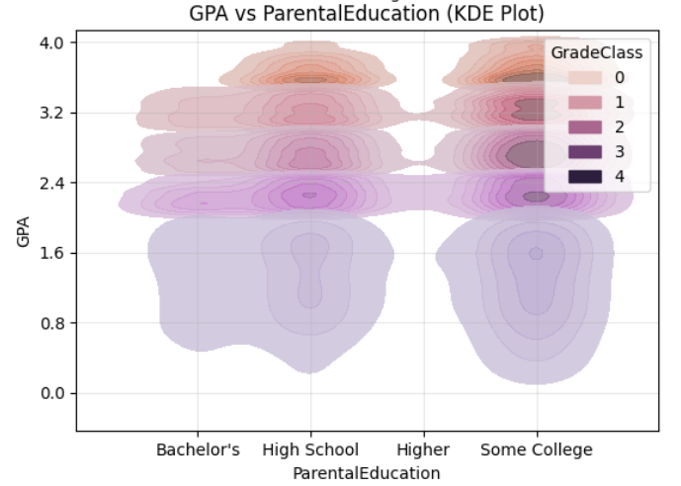
Finding #5: The Parental Education Gap
⚠️ CRITICAL EQUITY ISSUE: Educational advantages perpetuate across generations.
High School Parents
2.4 - 2.8
GPA Range
Bachelor's+ Parents
3.2 - 4.0
GPA Range
💡 Action Plan: Break the cycle of educational disadvantage.

Slide 12
03
Model & Deployment

Slide 13
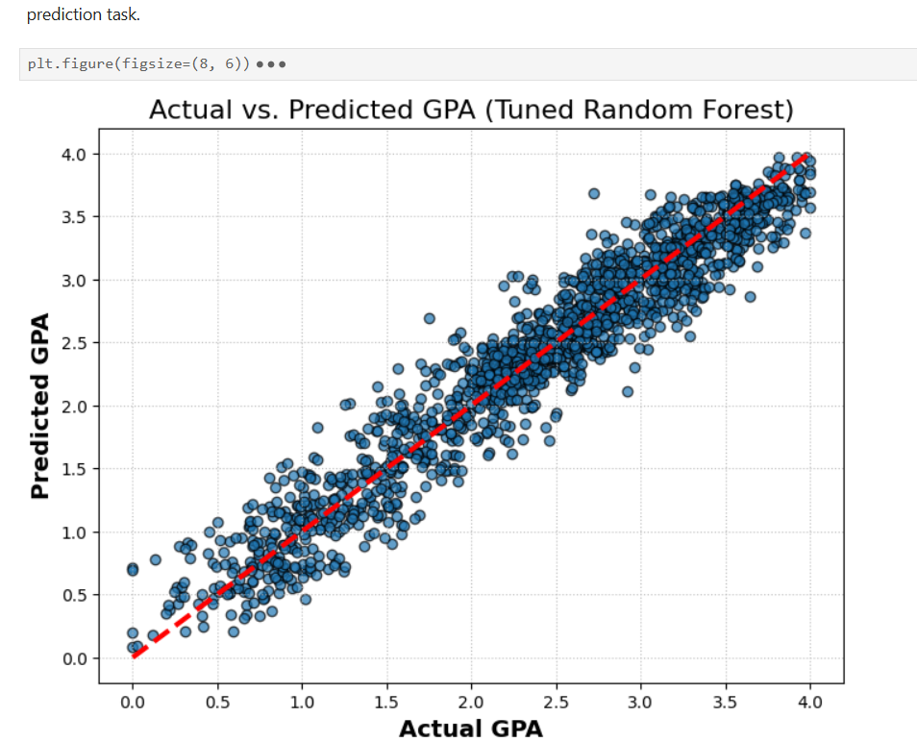
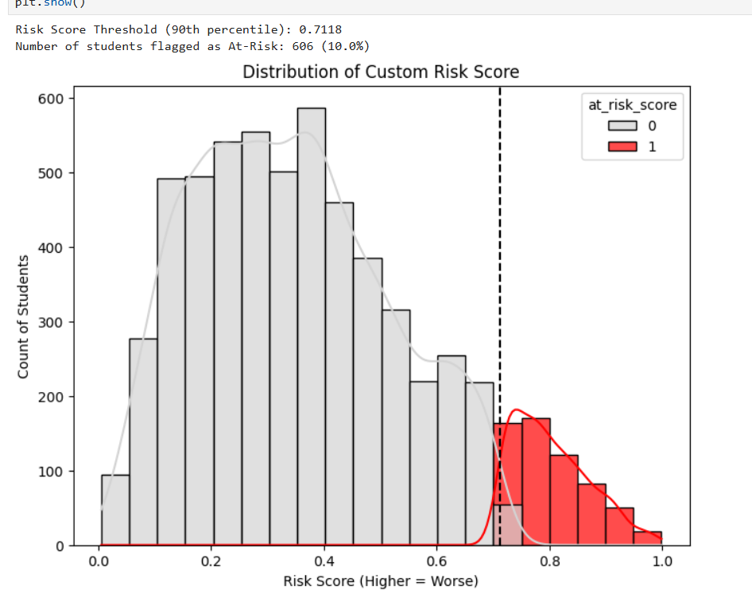
Model Performance: Exceptional Results
92.88%
Perfect
99.61%
606
R-squared Score
Precision / Recall
Classification Accuracy
Students Flagged
RandomForest Regression
1.00 / 1.00
Logistic Regression
90th percentile threshold
The model doesn't just predict—it enables early intervention BEFORE students fail.

Slide 14
From Insights to Impact: Implementation Roadmap
Immediate (0-3 Mo)
Medium-Term (3-12 Mo)
Long-Term (1-2 Yr)
Deploy dashboards, launch tutoring for 606 at-risk students, monitor attendance.
Expand clubs, establish first-gen mentorship, complete dashboard training.
Personalized learning, scale interventions, proactive educational culture.

Slide 15
04
ROI & Close

Slide 16
Business Impact & ROI Analysis
$375K-525K
→
$18-30M
=
35:1 to 60:1
Annual Investment
Retention Revenue
ROI
Quantifiable Benefits:
Additional Impact:
Prevent dropout for 606 high-risk students.
15-25% retention improvement.
Mean GPA increase: +0.3 to +0.5 points.
40% improvement in intervention ROI.
Enhanced institutional rankings.
Stronger recruitment outcomes.

Slide 17
The Bottom Line
Education deserves proactive intervention, not reactive responses.
92.88% accuracy enables early intervention.
606 students identified as high-risk BEFORE failure.
Attendance, tutoring, engagement are key drivers.
Equity gaps require targeted intervention.
ROI of 35:1 to 60:1 makes this business-smart.
The question isn't whether we CAN predict success—
it's whether we'll ACT on what the data tells us.

Slide 18
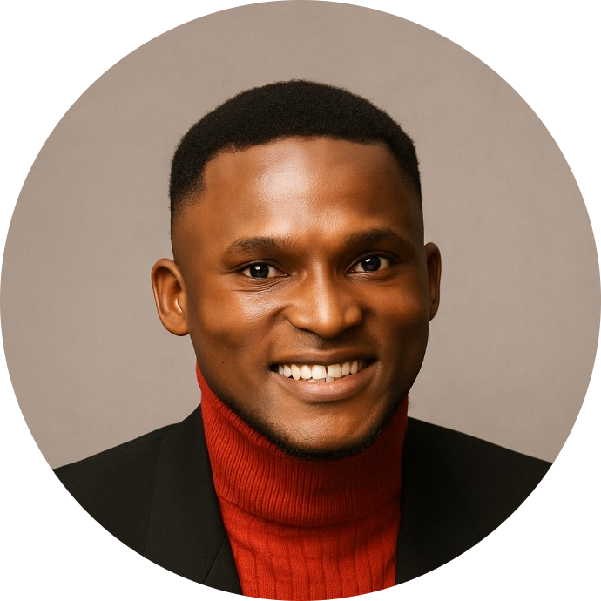
Let's Connect & Collaborate
Email: christianmide6@gmail.com
LinkedIn: linkedin.com/in/odunayomide-yakubu
GitHub: github.com/ODUNAYOMIDE-YAKUBU
Project Repository:
Odunayomide Yakubu
github.com/ODUNAYOMIDE-YAKUBU/Student-Performance-Analysis-and-Predictive-Modeling
Data Scientist & Analyst
Key Metrics: 6,055 students analyzed | 92.88% accuracy | 606 at-risk students identified

